Slide 1

Tech Career Full Stack Developer BootCamp Graduation Project
Electrical Electronics Engineer
Kerem Talha KARGA
Teacher
Master Com. Eng. Hamit Mızrak

Slide 2
To Do List Application
We used N-tier architecture to create an understandable program structure.
We used DTOs (Data Transfer Objects) to transfer data between two data layers.
We used entities to store data in the database.
We used repositories because help us for reach the databases

Slide 3
Annotations
When we use annotation we don’t have to write all POJOs.
For examples Getter Setters.
We use getter and setters for get and set the datas.
Normally we have to write getter setter for all written datas.
But When we use annotation We dont have to Write getter setter because they work behind the Project.

Slide 4
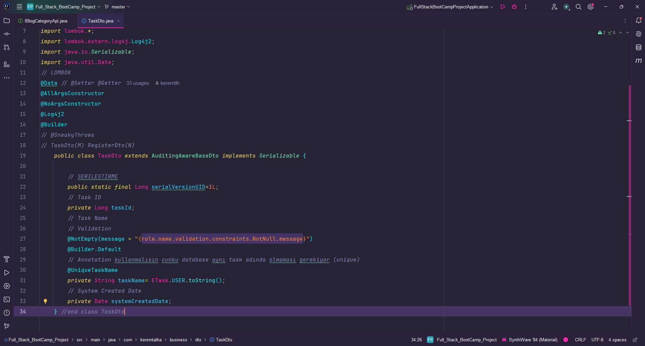

Slide 5
If we want to use an interface at the different places more than one. We use implements for this work.
Annotation help us for write short code structures.
When we use annotation we don’t have to write all getter and setters.

Slide 6
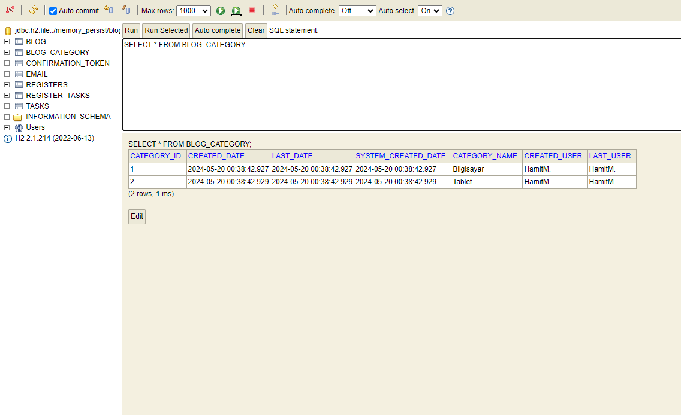
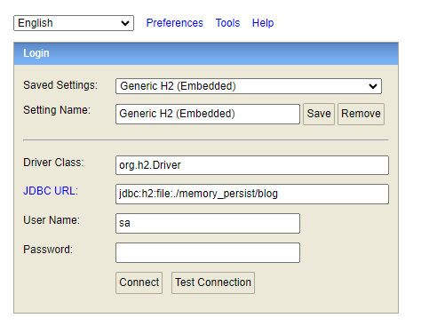
H2 DATABASE

Slide 7
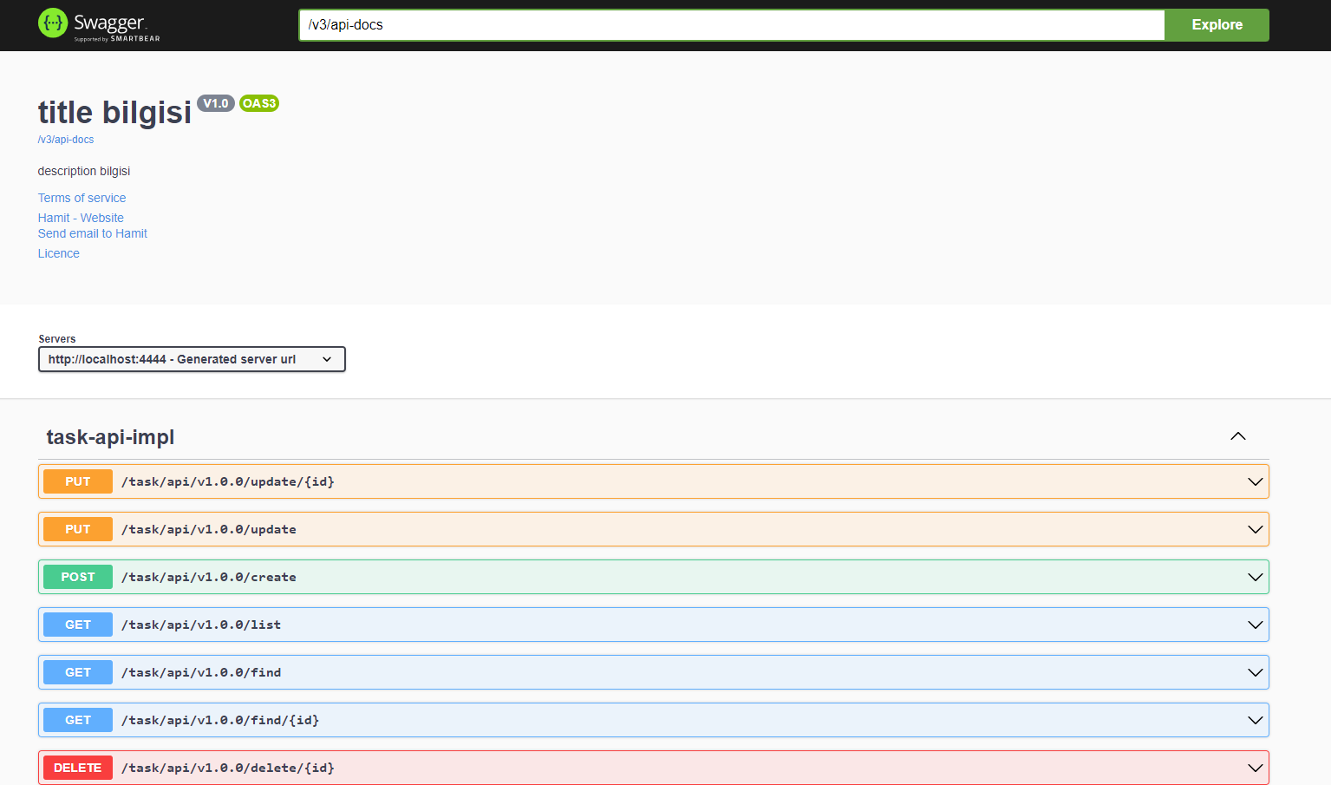
Swagger Uİ
We used the Swagger UI interface. We used this interface to test our database actions.
These actions are CRUD (Create, Read, Update, Delete) actions.
We can add new materials to our database by Swagger Uİ

Slide 8
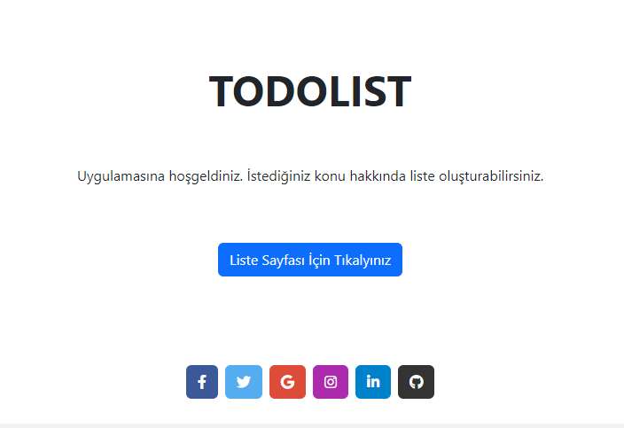
Main Page
When we click the button, the list page will open.
We used port localhost:3000 for the main page

Slide 9
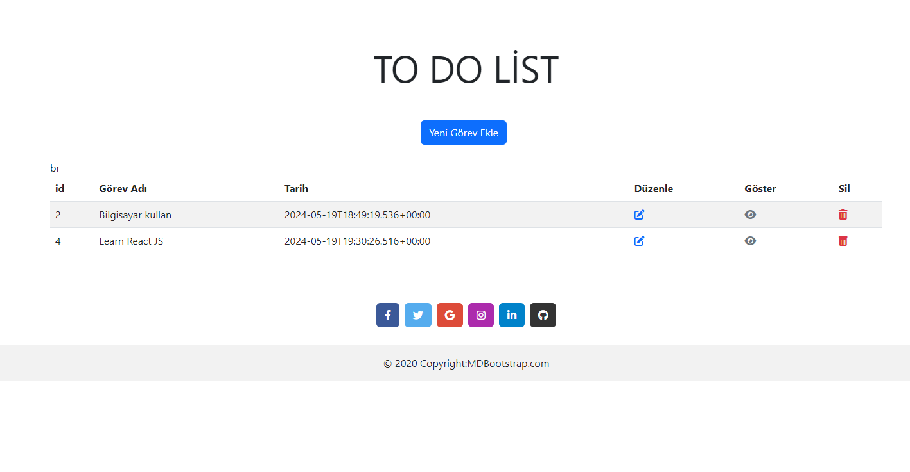
List Page
We can see all list materials in this section.

Slide 10
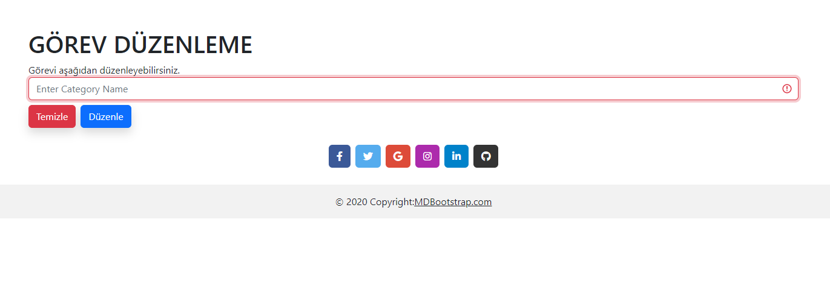
Edit Page
If we want to edit our Project we should press the edit button.
When we click the button this page will open.
We can modify our list contents here.

Slide 11
Thank you for listening

